Slide 1

WRIT-231-40: Technical Writing – Spring 2023
Gael Mbala
Comprehensive Plan to integrate Microsoft Teams to Azure

Slide 2

Background

Slide 3






Thesis
The hybrid work model has revolutionized our perception of the workplace. While many companies are still working on crafting a post-Pandemic plan, others have invested in collaboration tools to bring employees together and optimize innovation. With flexibility and work-life balance being expected by over 70% of employees, the unexpected transition to video conference and screen share technologies re-affirmed the proliferation of Microsoft Teams, Zoom, Webex, and similar software on our work computers.

Slide 4
Thesis
Hybrid work is here to stay. More than 80% of employees believe a good work-life balance is essential to maintaining a healthy lifestyle. However, many organizations have struggled to meet work flexibility, causing employees to seek new positions. To resolve this issue, integrating Azure DevOps into Microsoft Team is crucial for remote and hybrid employees to achieve a work-life balance, and increase productivity.

Slide 5
Microsoft Teams
Slack
Users can schedule or modify meetings on the platform without having to open a separate app.
Knowledge base built upon FAQ pages to manage tier one requests sent to IT
Content pane allows for easy calendar, channel, and access
Quick Switcher option to easily navigate through channels using a shortcut command
Allows users to save important messages on the “Saved items” list for future reference.
Integrated “Slackbot” helps with reminders and notetaking to optimize productivity

Slide 6
Azure Logic Apps & Automation
Logic Apps are a cloud platform where business processes and workflows are created and orchestrated
Can easily be integrated with apps and services from Azure marketplace via connectors
They’re not to be mistaken with Power Automate, which manages data loss prevention (DLP) policies
Logic Apps are serverless and scalable

Slide 7
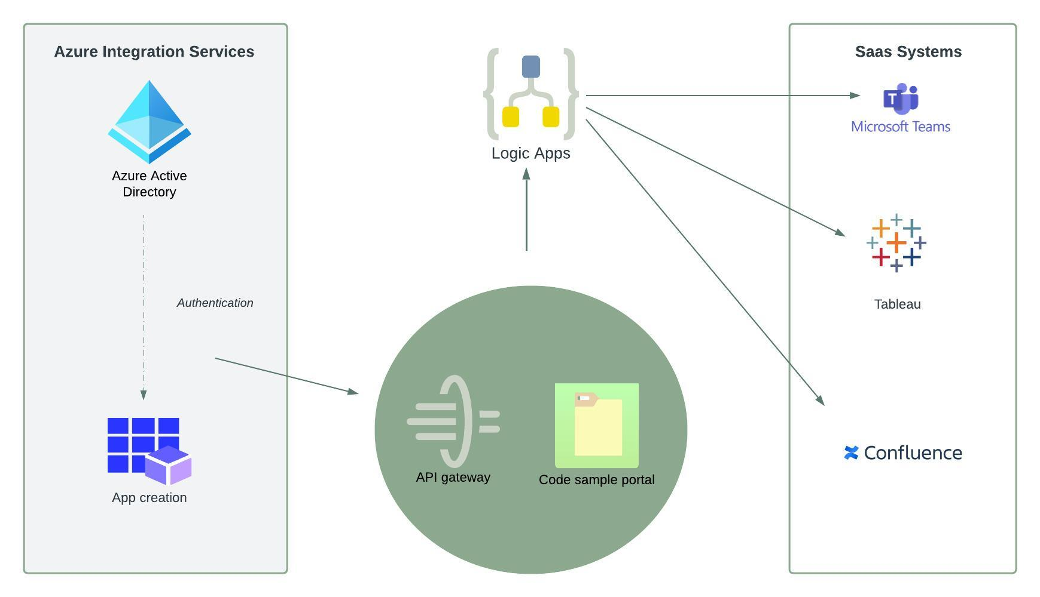
App Orchestration Architecture

Slide 8
Azure Active Directory
Central identity management service
Conditional access to protect organizational assets
SSO sign in system
Supports various protocols for authentication including Oauth 2.0 and SAML 2.0

Slide 9
Basic Considerations when Configuring Azure AD
Using an open-source image will drastically reduce integration costs
Setting up appropriate network security groups is vital to maintaining an agile and scalable cloud environment as global administrators can limit permissions by setting up appropriate IP whitelisting to ensure that threat actors don’t interact with the infrastructure in case Microsoft Teams is compromised
For archiving data, storing in HDD will reduce costs, but for data that needs to be readily accessed and processed an SDD solution may be better.

Slide 10

BYOD Policies & Security
Almost 50% of security breaches happen due to stolen or lost devices. The lack of a strong BYOD policy makes Teams channels vulnerable to DOS (Denial of Service) attacks.
Integration means defining a BYOD policy that fosters a solid work-life balance

Slide 11
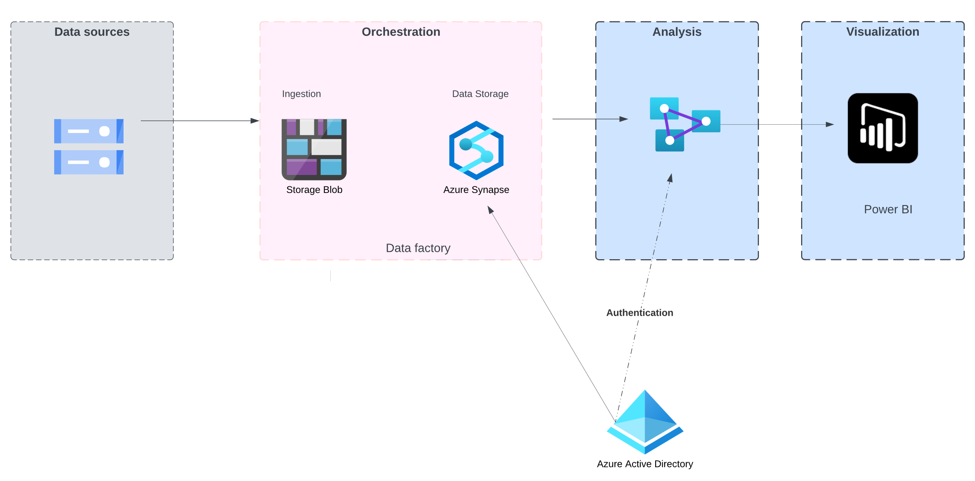
Azure Data Factory

Slide 12
Pipeline Runs & Control Flow
API connectors offer users the opportunity to pipeline data both on-premises and in the cloud and store them into a repository.
As E. Boyd (Q&A, January 26, 2023) suggested, users can easily clean up or transform data into a full-blown activity from data sources all the way to visualizing those using business intelligence. In addition, activities are scheduled in terms of start and end dates.
Azure Data factory allows users to store temporary values in variables in conjunction with parameters to enable sharing values between various pipelines and data flows.

Slide 13
Conclusions
Logic App workflows make it easier for business processes to be visualized and automated hierarchically.
Users can create work items from conversations in the channel and share them with teammates using the messaging extension.
Azure has more certifications than any Cloud provider.
The Azure Active Directory’s “Connect” feature allows users to access confidential information using the same credentials both on-premises and in the cloud.

Slide 14
RECOMMENDATIONS
Enhancing cross-functional communication to accelerate deployment
Build a team that champions the integration of Azure with Teams
Training employees on creating and managing work items using Azure Boards
Identifying new opportunities caused by the deployment of cloud solutions

Slide 15
References
Altaiar, H., Babel, I., Lee, J., et al. (2022). The Developer's Guide to Azure. Redmond; Packt Publishing.
Basic enterprise integration on azure - azure architecture center. Azure Architecture Center | Microsoft Learn. (n.d.). Retrieved February 10, 2023, from https://learn.microsoft.com/en-us/azure/architecture/reference-architectures/enterprise-integration/basic-enterprise-integration
Blair, N. (2023, February 10). Personal communication [Email]
Boyd, E. (January 26, 2023) Online chat [Live Q&A]
Nesbo, E. (2021, April 23). Is Dropbox secure enough for your private files? MUO. Retrieved February 9, 2023, from https://www.makeuseof.com/is-dropbox-secure-enough-for-your-private-files/
Groysberg, B.,Haas, D., & Lin, E. (2022, December). Now You See Me, Now I’m Gone. MIT Sloan Management Review, 70. https://link-gale-com.cobalt.champlain.edu/apps/doc/A734809517/OVIC?u=vol_b92c&sid=bookmark-OVIC&xid=4430e22e
Pratt, M. (2023, January 24). CIOs sharpen tech strategies to support hybrid work. CIO. Retrieved January 24, 2023, from https://www.cio.com/article/419628/cios-sharpen-tech-strategies-to-support-hybrid-work.html
Reed, J. (TBD). Personal communication [Personal interview]
Trevor, J., & Holweg, (2022, December). M. Managing the New Tensions of Hybrid Work. MIT Sloan Management Review, 35. https://link-gale-com.cobalt.champlain.edu/apps/doc/A734809510/OVIC?u=vol_b92c&sid=bookmark-OVIC&xid=c4aedf66
What is Data Center virtualization?: Glossary. HPE. (n.d.). Retrieved February 9, 2023, from https://www.hpe.com/us/en/what-is/data-center-virtualization.html#:~:text=Data%20center%20virtualization%20is%20the%20process%20of%20creating%20a%20virtual,with%20help%20from%20a%20hypervisor.

